Slide 1
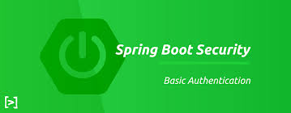
Live Virtual Class on Unit-15
Spring Boot Security
Rahul Dixit

Slide 2

Agenda
Securing Web Applications
Authentication and Authorization
Configuration of Authentication
Types of Spring Boot Web Security
JWT Tokens
JWT Tokens in Spring Boot Security

Slide 3
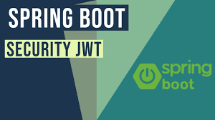
Spring Boot Security Introduction

Slide 4
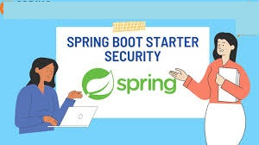
Spring Boot Security
Web applications play a significant part in our interconnected advanced world, encouraging communication, commerce, and collaboration.
Be that as it may, the delicate nature of the information and operations dealt with by web applications makes them vulnerable to different security dangers.
Security is fundamental in web advancement for the taking after reasons

Slide 5
Spring Boot Security
Information Assurance: Web applications regularly bargain with delicate client information, counting individual data, monetary subtle elements, and private archives.
Guaranteeing information security is crucial to preserve client believe.
Commerce Progression: Security breaches can lead to benefit disturbances, budgetary misfortunes, and reputational harm. Securing against assaults makes a difference keep up trade coherence.
Lawful and Administrative Compliance: Numerous businesses have controls (e.g.,GDPR, HIPAA) that order the security of client information. Non-compliance can result in noteworthy legitimate results.
Client Believe: Clients anticipate their data to be secure when connection with web applications. A breach of believe can lead to client steady loss and harm to brand notoriety.

Slide 6
Common Security Dangers
SQL Infusion (SQLi)
Aggressors infuse noxious SQL inquiries into input areas to control or recover unauthorized information from the database. Avoidance: Utilize parameterized inquiries and arranged explanations to sanitize client inputs.
Cross-Site Scripting (XSS)
Aggressors infuse malevolent scripts into a web application, which are at that point executed by Exclusive substance. All rights saved. Unauthorized utilize or dissemination disallowed. clueless users' browsers. Anticipation: Sanitize and approve client inputs, and utilize yield encoding to avoid script execution.
Cross-Site Ask Imitation (CSRF)
Aggressors trap clients into performing activities without their information or assent by misusing their confirmed sessions. Avoidance: Utilize tokens to approve and verify demands to guarantee they begin from the genuine client.

Slide 7
Common Security Dangers
Brute Drive Assaults
Aggressors endeavor to pick up unauthorized get to accounts by attempting different username and secret word combinations. Anticipation: Execute account lockouts, CAPTCHA, and solid watchword approaches.
Session Seizing
Aggressors take users' session tokens to imitate them and pick up unauthorized get accounts. Avoidance: Utilize secure treats, execute session timeouts, and empower HTTPS.
Security Misconfigurations
Ineffectively designed security settings, default qualifications, and uncovered touchy data can be misused by aggressors. Anticipation: Routinely survey and upgrade security arrangements.

Slide 8
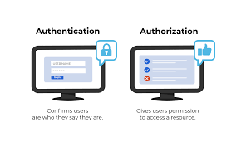
Spring Boot Authentication and Authorization

Slide 9
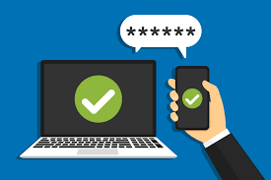
Authorization
Authorization
Authorization determines what actions an authenticated user is allowed to perform within the application. It defines the user's level of access and controls their ability to interact with different parts of the application. Role-based and permission-based authorization are common methods to manage access control.
Role-Based Authorization:
Users are assigned roles (e.g., admin, user, moderator). Different roles have different access levels to various parts of the application. Role information is usually stored in the user's profile or database record.
Permission-Based Authorization:
Users are assigned specific permissions or privileges. Fine-grained control over user access to specific actions or resources. Permissions can be dynamic and assigned based on user attributes or other factors.

Slide 10
Key Question is how to identify Users?
And How to Configure resources they can access & action that are allowed.
Authentication (is it a right User)
UserId | Password what user remember.
Biometric Scan what user posses.
Authorization (do they have right access)
User xyz can only read data.
User ABC can read | Update the data.

Slide 11
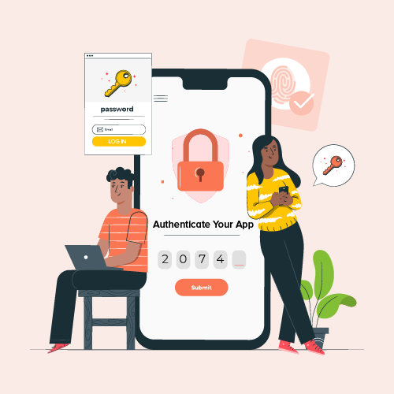
Authentication
Authentication and authorization are two fundamental concepts in web application security that work together to control access to resources and ensure the integrity of user interactions.
Authentication
Authentication is the process of verifying the identity of a user, ensuring that they are who they claim to be. It ensures that only authorized users are allowed to access certain parts of an application or perform specific actions. Various authentication methods can be used to verify user identity, including passwords, biometrics, tokens, and more.
Types of Authentication includes
* Basic Authentication
* Form Based Authentication
* Token Based Authentication

Slide 12
Authentication
Basic Authentication:
Users provide their credentials (username and password) with each request. Credentials are Base64-encoded and sent in the request headers. Considered less secure for sensitive applications as credentials are easily visible.
Form-Based Authentication:
Users provide credentials through an HTML form. The server validates credentials and issues a session cookie upon successful authentication. Commonly used for web applications with user interfaces.
Token-Based Authentication:
Users receive a token upon successful authentication, which is included in subsequent requests. Stateless and suitable for distributed architectures. Commonly used with RESTful APIs and single-page applications (SPAs).

Slide 13
Security Principles
Require strong security as its weakest link.
Weak security flaw makes an app with robust architecture vulnerable.
Trust Nothing
Validate everything
Assign least Privileges :
Security design should be start from the starting of the project.
Clear picture of user roles and access
Assign minimum possible Privileges at all levels

Slide 14
Have complete Mediation
Everyone has to pass through one main gate .
Have defense in depth
Multiple level Security Check
Have Economy of Mechanism
Security Architecture Should be simple
Ensure Openness of Design
Easier to identify a fix security flaws

Slide 15
Intercepts Everything
Spring Security Intercepts All Requests
Request
Security
Dispatcher
Controllers

Slide 16
Default Spring Security Configuration
Everything is Authenticated
You can Customized further
Whether the asking resource exits on the system or not.
Form Authentication is enabled
With default login form and logout features
Basic authentication enabled
Test User is Created
Credential printed in log (Username is user)
CSRF Protection is enabled
CORS requests are denied by default
X-frame Options is set to (frames are disabled )
Etc…….

Slide 17
Cross Origin Resource Sharing (CORS):
Does not allow calls from other domains by default.
Cross Site Request Forgery (CSRF):
A malicious website making use of previous authentication on your website.
Default CSRF protection enabled for updates request put|Post etc
Login Page | Logout Page etc
Order of filter :
Basic Check Filter : CORS|CSRF
Authentication Filter
Authorization Filter

Slide 18
Basic Authentication
Base 64 encoded username and password is sent as request header.
Disadvantage :
Easy to decode :Anyone get authorization header and easily decode it
Does not contain any authorization info.
Does not have expiry date.

Slide 19
Dependency
<dependency>
<groupId>org.springframework.boot</groupId>
<artifactId>spring-boot-starter-security</artifactId>
<version>3.2.0</version>
</dependency>

Slide 20
Configuration [to create static credential]
spring.security.user.name=rahul
spring.security.user.password=1234

Slide 21
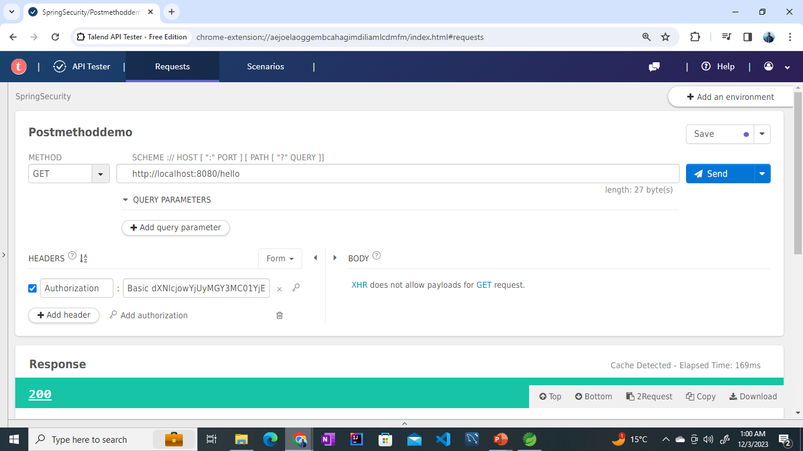

Slide 22
CSRF – Cross Site Request Forgery
You logged in to any web application
A cookie is saved in your web browser
You navigate to some malicious web site without logged out.
Malicious website can executes accessing your application without your knowledge using the cookie.

Slide 23
CSRF – Cross Site Request Forgery
? How can you protect from CSRF
Synchronizer token pattern
A token created for each request
To make an update (post , put ,….) you need a csrf token from the previous request.
Spring security Enables by default
2. Same site Cookie
server.servlet.session.cookie.same-site=strict

Slide 24
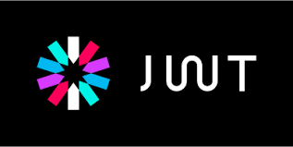
JWT Tokens in Spring Boot

Slide 25
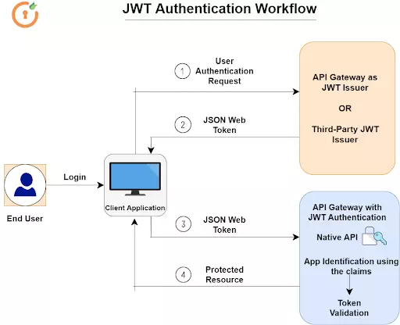
JWT Tokens Work Flow

Slide 26
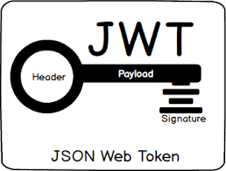
JWT Tokens
JSON Web Tokens (JWT) are a popular way to securely transmit information between parties in a compact and self-contained format.
JWT tokens are often used for authentication and authorization in web applications, APIs, and microservices. In the context of Spring Boot Security, JWT tokens can be used to implement token-based authentication and authorization.
Parts of JWT Tokens
JWT is composed of three parts:
Header: Contains information about the algorithm used to sign the token and the type of token it is.
Payload: Contains claims, which are statements about an entity (typically the user) and additional metadata.
Signature: Used to verify that the sender of the JWT is who it says it is and to ensure that the message wasn't changed

Slide 27
JWT Tokens
JWTs can be digitally signed to ensure the integrity of the information they contain. This means that even though anyone can decode the contents of a JWT, they cannot modify it without invalidating the signature.
Using JWT Tokens in Spring Boot Security Spring Boot Security supports using JWT tokens for authentication and
authorization.

Slide 28
Uses of JWT Tokens
These are some scenarios where JSON Web Tokens are useful:
Authentication:
This is the typical scenario for using JWT, once the user is logged in, each subsequent request will include the JWT, allowing the user to access routes, services, and resources that are permitted with that token.
Single Sign On is a feature that widely uses JWT nowadays, because of its small overhead and its ability to be easily used among systems of different domains.
Information Exchange:
JWTs are a good way of securely transmitting information between parties, because as they can be signed, for example using a public/private key pair, you can be sure that the sender is who they say they are.
Additionally, as the signature is calculated using the header and the payload, you can also verify that the content hasn’t changed.

Slide 29
JWT Tokens
In authentication, when the user successfully logs in using their credentials, a JSON Web Token will be returned. Since tokens are credentials, great care must be taken to prevent security issues. In general, you should not keep tokens longer than required.
You also should not store sensitive session data in browser storage due to lack of security.
Whenever the user wants to access a protected route, it should send the JWT, typically in the Authorization header using the Bearer schema. Therefore the content of the header should look like the following.
Authorization: Bearer <token>

Slide 30
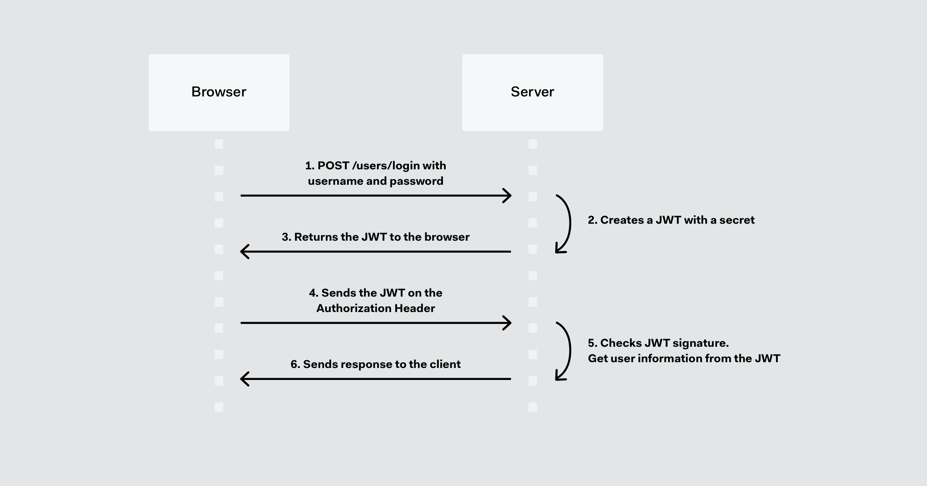
JWT Tokens
This is a stateless authentication mechanism as the user state is never saved in the server memory.
The server’s protected routes will check for a valid JWT in the Authorization header, and if there is, the user will be allowed.
As JWTs are self-contained, all the necessary information is there, reducing the need of going back and forward to the database.
This allows to fully rely on data APIs that are stateless and even make requests to downstream services. It doesn’t matter which domains are serving your APIs, as Cross-Origin Resource Sharing (CORS) won’t be an issue as it doesn’t use cookies.

Slide 31


Any doubts?

Slide 32

Summary
In this session we have learnt,
Securing Web Applications
Common Security Threats
Authentication and Authorization
Configuration of Authorization
Introduction of JWT Tokens in Spring Boot
Uses of JWT Tokens
Applications of JWT Tokens
DO NOT WRITE ANYTHING
HERE. LEAVE THIS SPACE FOR
WEBCAM

Slide 33


